Slide 1

Project 3: Flywheel Patterns
Melissa Young
05/31/2024
DSC680 – T301 Applied Data Science

Slide 2
Introduction & Business Problem
Analysis of Sales Flywheel Patterns
Background/History:
Understanding the addressable market and sales flywheels is essential for optimizing market strategies.
Sales Flywheel Concept:
Self-Sustaining Cycle: Each phase of the sales process builds momentum for the next, driving continuous growth.
Contrast with Sales Funnel: Unlike the traditional funnel, which ends at the point of sale, the flywheel approach promotes ongoing engagement and growth.
Business Problem:
Objective: Quantify and analyze addressable market percentages in key regions, starting with Tampa Bay, Florida.
Focus Areas:
Investigate sales flywheel patterns.
Derive actionable insights to:
Enhance market penetration strategies.
Streamline sales processes.
Predict optimal flywheel locations.

Slide 3
Data Sources
Warranty Sales List from MAV Corp: Comprising detailed records of warranty sales linked to various builders and projects under MAV Corp, this dataset is pivotal for understanding warranty penetration rates and customer retention. https://github.com/Joven0218/DSC680---Applied-Data-Science/blob/main/Project%2010/hub_msa.xlsx (Tab = Warranty Sales 19)
Tampa MSA Builders list from HubSpot: This list includes comprehensive data on builders within the Tampa Metropolitan Statistical Area (MSA), detailing operational scale, specialty, and historical sales performance. https://github.com/Joven0218/DSC680---Applied-Data-Science/blob/main/Project%2010/hub_msa.xlsx (Tab = Tampa MSA Builders)
Census Data for New Residential Sales: Sourced from the U.S. Census Bureau (https://www.census.gov/construction/nrs/current/index.html), this dataset provides monthly updates on the volume of new residential sales, which is crucial for tracking market fluctuations and emerging trends.
Census Data for New Residential Permitting: Also, from the U.S. Census Bureau (https://www.census.gov/construction/bps/current.html), this information reveals the rate of new residential permitting, serving as a leading indicator of construction and economic activity within the region.
Region Mapping Definitions: Essential for accurate geographical analysis, these definitions (https://www.census.gov/construction/soc/definitions.html) help standardize regional segmentation for mapping.

Slide 4
Data Preparation
Duplicate Removal:
• Datasets were checked for duplicate records using drop_duplicates(), ensuring that the analysis would be based on unique entries only.
• It was decided to drop null values from the dataset as it presented no loss of value.
Data Type Standardization:
• Ensured that state identifiers across datasets (StateId in warranty_sales and State/Region in tampa_msa_builders) were standardized by converting them to uppercase and stripping any extra whitespace.
• The cleaned dataset now had 158,010 rows and 16 columns.
Data Merging and Aggregation:
State-Level Aggregation
• Premiums and contract costs were aggregated by the state to analyze geographical distributions of market activity. This involved grouping by state and summing up premiums and contract costs, respectively.
Data Integration
• The aggregated data from both datasets were merged on the state identifier to facilitate a combined analysis, allowing us to view the total premiums and contract costs side by side for each state.
• The regions were mapped into merged dataset for analysis.

Slide 5
Analytical Approach
EDA using python libraries to understand the datasets and their data types and objects.
info()
describe()
isnull
melt
groupby, drop and rename
shape
sort_values
pd.merge
In anticipation of generating a predictive tool to identify the next flywheel location best suited to MAV operations, locations were identified using the beautiful soup python package to parse the census website and create a new data frame.
Predictive Modeling: Using statistical and machine learning algorithms, I constructed models to forecast market potentials and identify key drivers of the sales flywheel.
Logistic Regression: Developed a logistic regression model to predict the potential for successful market penetration, classifying regions as high or low potential based on their characteristics.
Random Forest: A secondary model to possibly assess and compare results, providing a deeper insight into feature importance and model robustness.

Slide 6
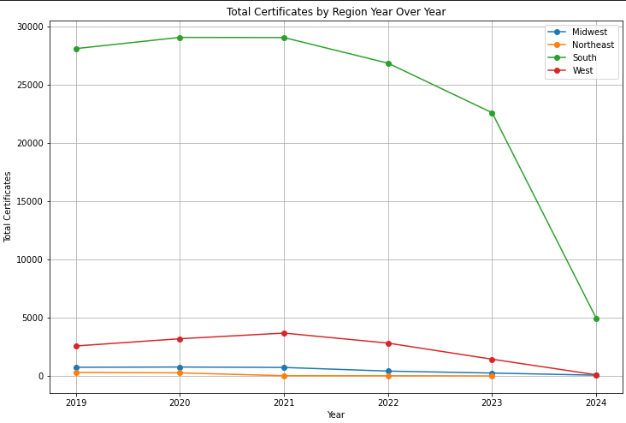
Key Findings
Visualizing key variables and their relationships:
After combining the datasets to include regions by counts of certificates sold, the visualization below depicts that the South has traditionally been the region of focus. This graph shows a decline in policies sold.

Slide 7
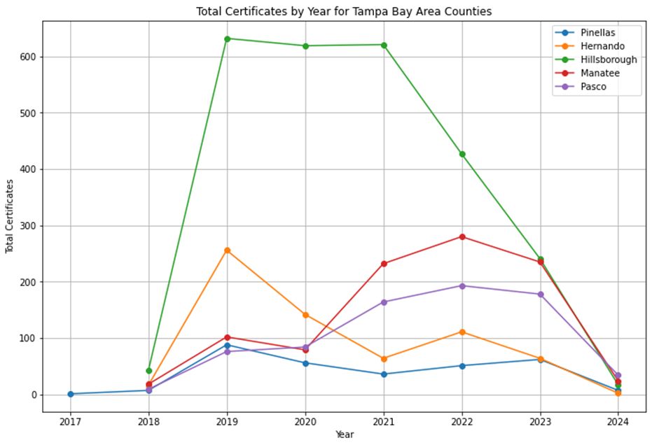
Key Findings
Pivoting to our area of focus, Tampa Bay – Florida, within the initial stages of the analysis

Slide 8
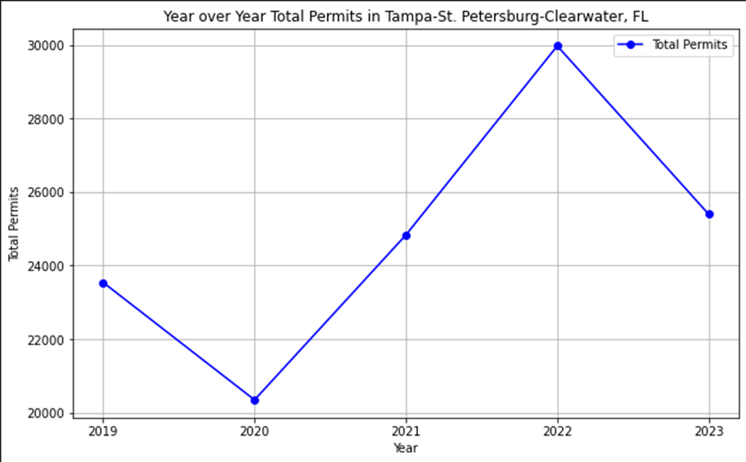
Key Findings
Showing Total permits for Tampa MSA:

Slide 9
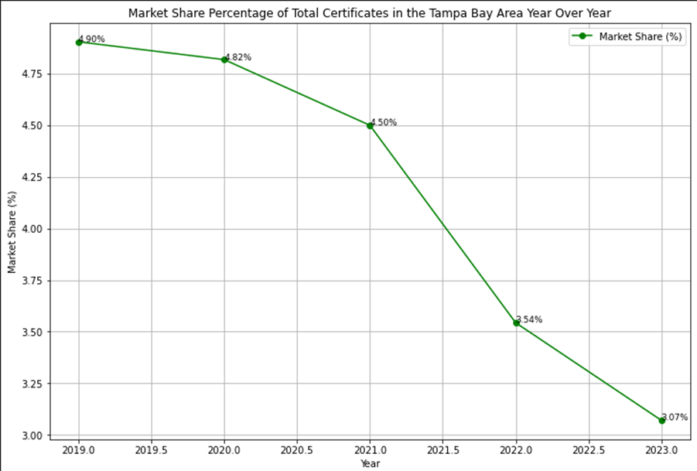
Key Findings
The analysis was generated to show MAV market share in the Tampa CBSA, From the graph below, you can see a steady decline, indicating a loss of market share.

Slide 10
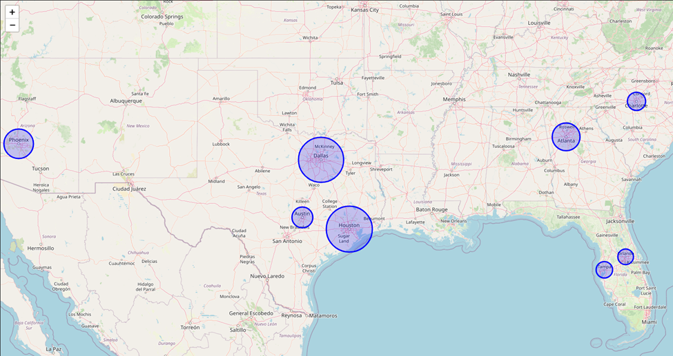
Key Findings
These areas were identified as potential targets of Flywheel concept initiation through the analysis and models.

Slide 11
Limitations and Challenges
• Data Scope and Availability: The availability and scope of the datasets used might not capture all relevant variables or may be limited to a specific geographic region or time.
• Historical Data Application: Using historical data to predict future trends assumes that past patterns will continue, which can be problematic in volatile markets.
• Generalizability: Insights and patterns may not always hold true across different market segments or external conditions.
• Data Quality and Integration: Inconsistencies in how data is collected, processed, and stored can affect integration and overall analysis.
• Data Integrity: Variabilities in data quality could impact the accuracy of insights. Regular audits and validation checks will be implemented to mitigate this risk.
• Adaptation to Regional Dynamics: The diverse economic landscapes across different regions may influence the generalizability of the models. Tailored approaches will be developed to accommodate local market conditions.

Slide 12
Recommendations
Focus on High-Potential Regions: Prioritize efforts in identified high-potential regions such as Houston, Dallas, and Austin. Allocate more resources and tailor marketing strategies to capitalize on these opportunities.
Strengthen the Texas Sales Team: Empower the Texas sales team with additional training, tools, and support to leverage their local market expertise. Encourage data-driven decision-making to maximize their effectiveness.
Investigate Declining Market Share: Conduct a thorough analysis to identify the factors contributing to the declining market share in Tampa Bay. Develop targeted interventions to address these issues.
Enhance Data Collection and Quality: Invest in improving data collection methods to ensure accuracy and completeness. Regularly update and validate datasets to support reliable analysis.
Expand Predictive Modeling: Continue developing and refining predictive models to identify emerging trends and opportunities. Use these insights to proactively adjust strategies and stay ahead of market shifts.
6. Collaborate Across Teams: Foster collaboration between sales, marketing, and data analytics teams to ensure a unified approach towards achieving business goals.

Slide 13
Ethical Considerations
Data Privacy Compliance: Adhere to GDPR and CCPA, ensuring explicit consent and robust data security.
Transparency & Accountability: Maintain open disclosure of data practices and establish mechanisms to address misuse.
Bias Mitigation: Actively identify and correct biases in data analysis and model application, ensuring fairness.
Stakeholder Engagement: Integrate feedback to minimize negative impacts and maximize societal benefits.
Sustainability Initiatives: Promote environmentally responsible practices and community well-being.
Continuous Ethical Education: Regularly update and educate on ethical standards to stay ahead of regulatory changes.

Slide 14
Thank You

